Slide 1
Growth Analysis & Action Plan for CarCARE
-Prasoon Singh

Slide 2
agenda
Introduction
September Growth Target Breakdown
August 2024 Performance Overview
RCA for August 2024
Planning for September 2024
Action Plan for Achieving 10,000 Service Jobs
Final tips & takeaways

Slide 3

Introduction
CarCare delivered 90% service jobs in August 2024. With a target of 10,000 for September, this presentation covers the August performance analysis and the growth plan for September.

Slide 4

September Growth Target Breakdown
For September, the growth target is set at 10,000 service jobs. With the addition of Kanpur city, the total number of cities is now 11, enhancing the probability of achieving this target.

Slide 5
August 2024 Performance Overview
In August 2024, CarCare set a target of 8,000 service jobs but achieved 7,200, resulting in a 90% achievement rate. This overview examines the performance across various cities and identifies the key factors contributing to the shortfall.

Slide 6
ROOT CAUSE ANALYSIS for august 2024
Factors Considered:
City-wise Breakdown
Cities with Significant Shortfalls: Indore (15% shortfall) and Lucknow (12% shortfall) and similarly other cities having shortfalls.
Possible Issues: Operational inefficiencies, market saturation, or resource allocation problems.
2. Channel-wise Performance
Underperforming Channels: BTL campaigns and Performance Marketing had lower conversion rates.
Effective Channels: Website/App and WhatsApp Bot performed relatively well but have room for improvement.
3. Lead Conversion Effectiveness
a) Overall Conversion Rate: Lower than expected, indicating potential issues in lead handling or follow-up processes.

Slide 7

Planning for September 2024
Key Cities :
Existing Cities: Bangalore, Mumbai, Indore, Hyderabad, Chennai, Coimbatore, Kochi, Lucknow, Noida, Pune
New City: Kanpur
Actions :
Performance Marketing
Increase Investment: Allocate additional budget to top-performing segments.
Optimize Targeting: Refine audience targeting based on performance data.
Enhance Creative: Improve ad creatives to increase engagement and conversions.
BTL (Below The Line)
Boost Lead Quality: Focus on higher quality leads through targeted campaigns.
Improve Outreach: Increase direct engagement through events and promotions.
Evaluate Channels: Analyze performance to reallocate resources to more effective BTL strategies.

Slide 8

Planning for September 2024
3. Website/App
Enhance User Experience: Optimize the website/app for better lead capture and conversion.
Increase Engagement: Implement new features or promotions to drive more conversions.
Track Metrics: Monitor user behaviour to identify and address drop-off points.
4. WhatsApp Bot
Boost Engagement: Increase the frequency and relevance of interactions.
Improve Automation: Enhance bot scripts to provide better lead nurturing.
Monitor Performance: Regularly review engagement metrics to make adjustments.

Slide 9
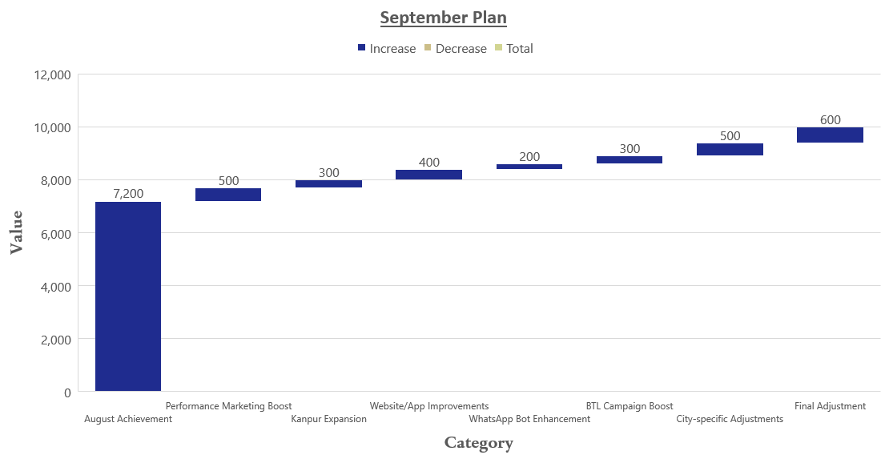
Waterfall chart for September

Slide 10
Action Plan to achieve target
Prioritizing high-impact areas to drive service job growth for September 2024.
1. City Focus:
Bangalore:
Action: Increase service capacity and promotional efforts.
Goal: Achieve 1,800 jobs.
Mumbai:
Action: Launch targeted marketing campaigns and optimize service processes.
Goal: Contribute 1,500 jobs.
Kanpur (New City):
Action: Establish initial service infrastructure and drive local awareness.
Goal: Achieve 300 jobs.
2. Channel Focus:
Website Leads:
Action: Enhance website functionality, improve lead capture forms, and launch targeted online ads.
Goal: Increase contributions to 2,000 jobs.
WhatsApp Bot Performance:
Action: Refine bot scripts, increase interaction frequency, and analyze engagement data.
Goal: Drive 1,500 jobs.

Slide 11
Action Plan to achieve target
Implementing key team activities and new initiatives to support the September target of 10,000 service jobs.
3. Team Activities:
Call Campaigns:
Action: Implement dedicated call teams to follow up on leads, focusing on high-potential prospects.
Goal: Convert leads into service jobs through personalized outreach.
Marketing Efforts:
Action: Roll out targeted marketing initiatives across various channels, including social media and local advertising.
Goal: Increase brand visibility and lead generation to support overall target achievement.
New Initiatives:
Action: Launch new promotions, partnerships, and referral programs to attract additional leads.
Goal: Enhance service job acquisition through innovative and engaging strategies.

Slide 12
Final tips & takeaways
Root Causes for August Underperformance: Identified key factors such as city-specific challenges, channel inefficiencies, and lead conversion issues that contributed to the 90% achievement.
Clear Strategy to Meet the 10,000 Target for September: Developed a focused plan addressing city priorities, enhancing channel performance, and implementing targeted team activities to achieve the goal.
Importance of City and Channel Performance: Emphasized the need to prioritize high-impact cities and optimize key channels to drive growth and ensure successful attainment of the September target.

Slide 13
Thank you
Prasoon Singh
prasoonsingh1216@gmail.com

